Slide 1

Credit card fraud detection
5ke-aung min hein

Slide 2
Problem formulation
A credit card is a thin handy plastic card that contains identification information such as a signature or picture, and authorizes the person named on it to charge purchases or services to his account.
They have a unique card number which is of utmost importance.
There is a rapid growth in the number of credit card transactions which has led to a substantial rise in fraudulent activities.
Therefore, credit card frauds are terms for theft and fraud committed using a credit card as a fraudulent source of funds in a given transaction.

Slide 3
What is a credit card fraud? How can it happen?
If your credit card becomes misplaced or taken, it can be used for unauthorized in person or online transactions.
The account number can also be taken, along with the PIN and security code. Criminals steal your information to make purchases that do not have required authentication.
Scammers can use skimmers on point-of-sale systems to get your information and use it to make a duplicate card.
Your information can be obtained online through hackers using unsecure or imposter websites & data breaches - then they can use your finance info to make purchases without needing the card present.

Slide 4
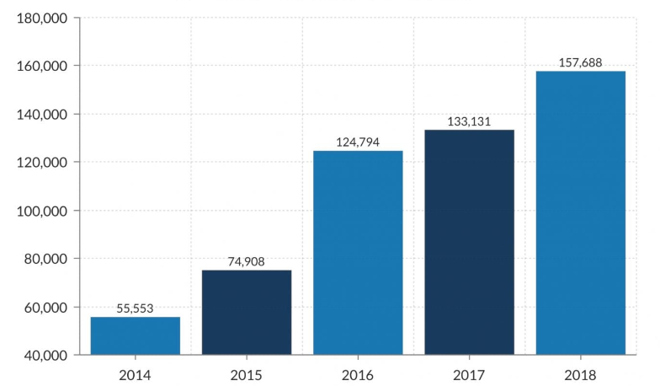
Credit card fraud report in united states

Slide 5
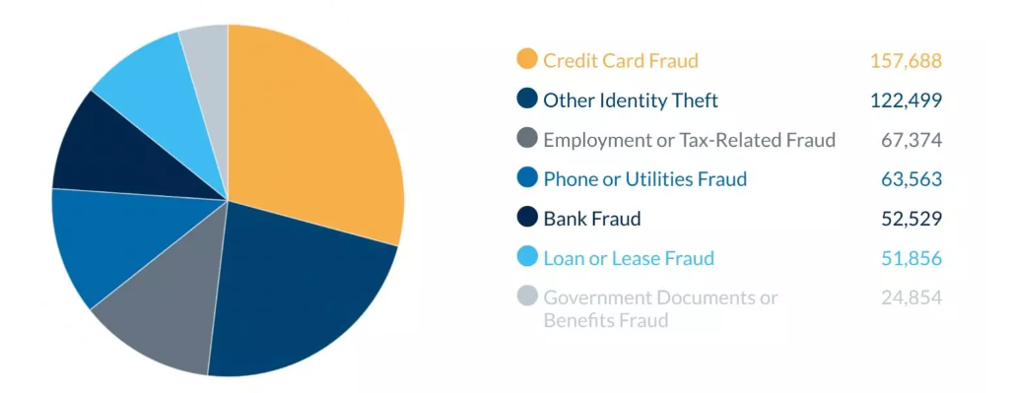
Identity theft reports(2018)

Slide 6
Data formulation and understanding
Generally, the statistical methods and many data mining algorithms are used to solve this fraud detection problem.
Most of the credit card fraud detection systems are based on artificial intelligence, machine learning, profiling and pattern matching.
The Genetic algorithms are evolutionary algorithms which aim to obtain the better solutions in eliminating the fraud.
A high importance is given to develop efficient and secure electronic payment system to detect whether a transaction is fraudulent or not.
In this presentation, based on the dataset we gathered, we will focus on credit card fraud and its detection measures via binary classification methods whether the transaction of the card is legitimate or not.

Slide 7
Data preparation
The dataset contains transactions made by credit cards in September 2013 by European cardholders.
This dataset presents transactions that occurred in two days, where we have 492 frauds out of 284,807 transactions.
The dataset is highly unbalanced, the positive class (frauds) account for 0.172% of all transactions.
It contains only numerical input variables which are the result of a PCA transformation since the data is confidential.
Given the class imbalance ratio, we have to balance the data by using ‘Sampling method’ after proceeding with the original dataset.
Since the dataset is gathered from trustable source, we can ensure that we are getting the data well structured.

Slide 8
Features to be considered
Current Job Descriptions
Real Estate Conditions
Family Status
Marital Status
Ownerships
Networth
Annual Income
Cash Loans

Slide 9
modeling
For credit card fraud detection, we mainly used-
Logistic Regression Classifier
Decision Tree Classifier
K-Neighbors Classifier
Gaussian Naïve Bayes Classifier
Support Vector Machine(SVM)
Random Forest Classifier

Slide 10
Evaluation
Since the data is consistent, we can ensure that we are getting a high amount of precision, recall and F1 scores via this credit-card-fraud dataset.
Firstly, after processing with the unbalanced processed data, we can get precision and F1 scores of above 99%
Because of the unbalanced dataset, we had to regenerate new dataset by providing with under-sampling and over-sampling.
Since the data is already consistent and we are getting the balanced dataset, we are getting precision and F1 scores of above 91% with this dataset.

Slide 11
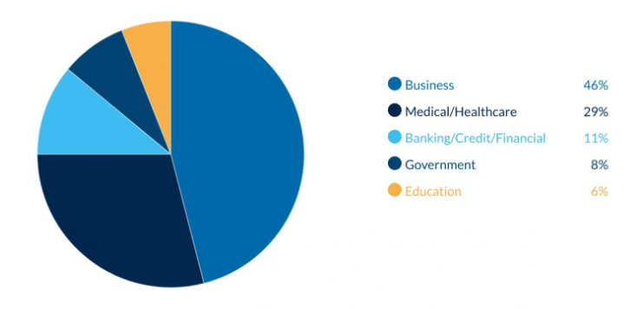
Data breaches in business sector(2018)

Slide 12
Deployment and analysis for real life situations
Nowadays, fraud detection is applied to many industries such as banking, insurance and some of the supermarkets.
In banking, fraud may include forging checks/credit cards or using stolen credit cards.
In this era, most of the data analysts are solving various kinds of fraud detection problems via various kinds of tools and algorithms.
Furthermore, some of the frauds including fake credit cards are enormously spreading throughout the world.
Other forms of fraud may involve exaggerating losses or causing an accident with the sole intent for the payout.

Slide 13
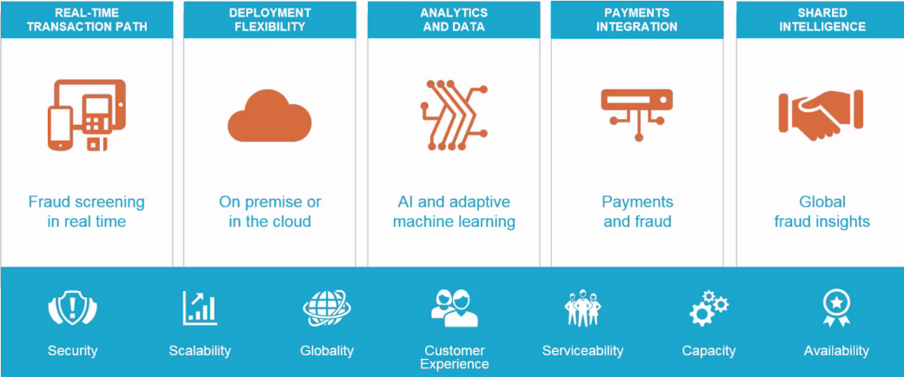
Real life credit card fraud detection deployment steps

Slide 14
Prevention measures
Mainly in this era, most of the prevention measures that are responsible both for the owner and the monitoring agencies are-
One needs to keep his/her credit card safe and monitor the card transactions online
Avoiding trails of one’s card number and signing of bank receipts
Making strong passwords and using RFID Blocking Wallets
Reviewing the billing statement and immediate reporting of lost and stolen card
And lastly, one must not do credit card transactions mostly in public.

Slide 15
dataset
https://www.kaggle.com/datasets/mlg-ulb/creditcardfraud

Slide 16


